Slide 1
PARKINSON’S DISEASE DETECTION THROUGH USING DEEP LEARNING
Under the Guidance Of:
Dr. Md Farukh Hashmi
ECE Department
Submitted By:
Swathi Sesetti– 21331A05G4
Saba Tanveer Khan– 21331A05F0

Slide 2
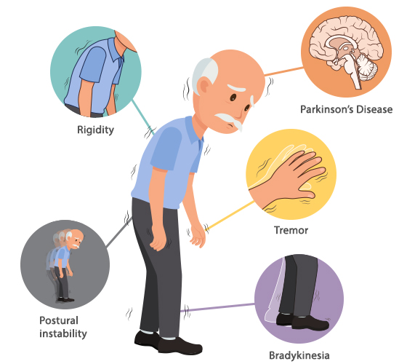
PARKINSON’S DISEASE-
Parkinson’s disease is a condition where a part of your brain deteriorates, causing more severe symptoms over time. While this condition is best known for how it affects muscle control, balance and movement, it can also cause a wide range of other effects on your senses, thinking ability, mental health and more.

Slide 3
Who does it affect?
The risk of developing Parkinson’s disease naturally increases with age, and the average age at which it starts is 60 years old. It’s slightly more common in men and people assigned male at birth (AMAB) than in women and people assigned female at birth (AFAB).
While Parkinson’s disease is usually age-related, it can happen in adults as young as 20 (though this is extremely rare, and often people have a parent, full sibling or child with the same condition).

Slide 4
SYMPTOMS
Motor symptoms — which means movement-related symptoms — of Parkinson’s disease include the following:
Slowed movements
Tremor while muscles are at rest
Rigidity or stiffness
Unstable posture or walking gait
Cramped or small handwriting
Drooling
Trouble swallowing
Non-motor symptoms
Several symptoms are possible that aren’t connected to movement and muscle control.
Autonomic nervous system symptoms
Depression
Loss of sense of smell
Sleep problems

Slide 5
CAUSES:
No One Definitive Cause of Parkinson’s. Parkinson's causes are likely a blend of genetics and environmental or other unknown factors. “About 10 to 20 percent of Parkinson's disease cases are linked to a genetic cause,” says Ted Dawson, M.D., Ph. D., director of the Institute for Cell Engineering at Johns Hopkins.

Slide 6
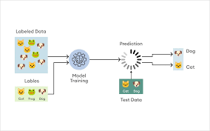
IMAGE CLASSIFICATION:
Image classification is an important task, as it is used to identify an object that appears in an image. This task consists of labelling input images with a probability for the presence of a particular visual object class. Image classification refers to the task of extracting information classes from a multiband raster image. The resulting raster from image classification can be used to create thematic maps.

Slide 7
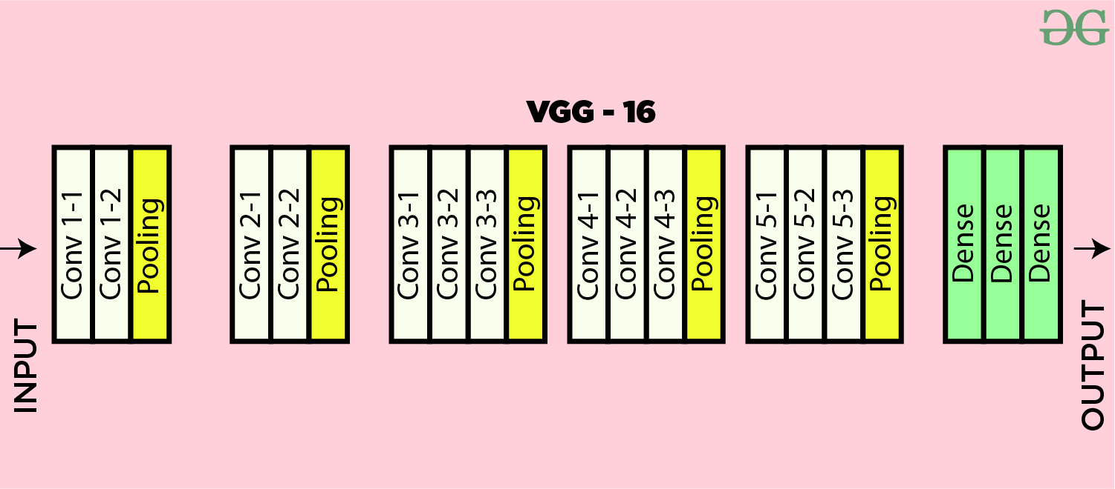
VGG16
VGG-16 is a convolutional neural network that is 16 layers deep. You can load a pretrained version of the network trained on more than a million images from the ImageNet database. The pretrained network can classify images into 1000 object categories, such as keyboard, mouse, pencil, and many animals.

Slide 8
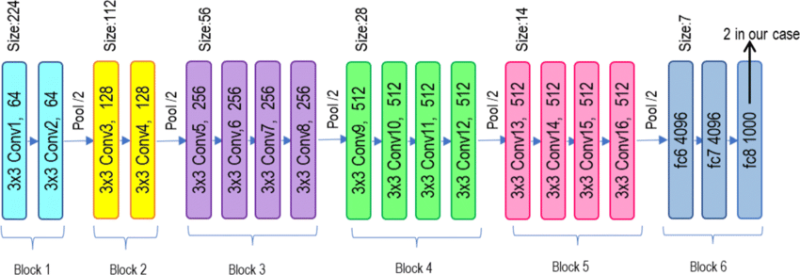
VGG19
VGG-19 is a convolutional neural network that is 19 layers deep. You can load a pretrained version of the network trained on more than a million images from the ImageNet database. The pretrained network can classify images into object categories, such as keyboard, mouse, pencil, and many animals.

Slide 9
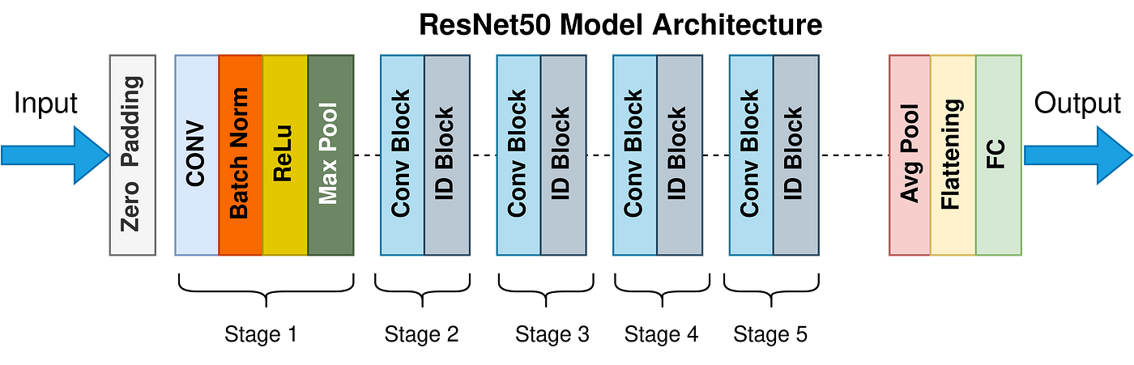
RESNET-50
ResNet-50 is a convolutional neural network that is 50 layers deep. You can load a pretrained version of the neural network trained on more than a million images from the ImageNet database. ResNet-50 is often used in transfer learning scenarios. Pre-trained ResNet-50 models, trained on large datasets like ImageNet, can be fine-tuned on smaller datasets for specific tasks.

Slide 10
Advantages of using Deep Learning in Parkinson’s Disease Detection
Improved Diagnosis
Progression Monitoring
Symptom Prediction and Management
Drug Discovery and Development
Patient Stratification
Remote Monitoring and Telemedicine
Enhanced Understanding of Disease Mechanisms

Slide 11
Disadvantages of using Deep Learning in Parkinson’s Disease Detection
Data Requirements
Overfitting
Complexity and Interpretability
Computational Resources
Expertise
Ethical and Legal Concerns
Integration with Clinical Practice
Maintenance and Updates

Slide 12
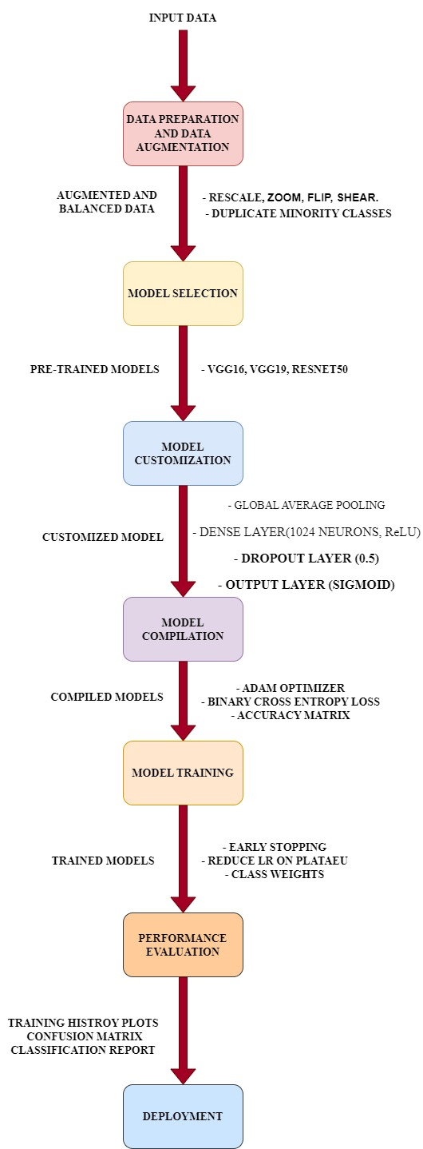
ARCHITECTURE

Slide 13
DATASET
Classes | Training Set | Validation Set | Testing Set
Healthy | 1305 Images | 565 Images | 81 Images
Parkinson | 1305 Images | 246 Images | 81 Images
Total Percentage | 2610 Images 80% | 811 Images 5% | 162 Images 15%

Slide 14
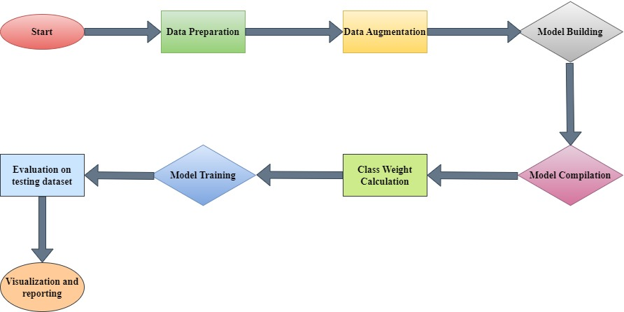
ALGORITHM

Slide 15
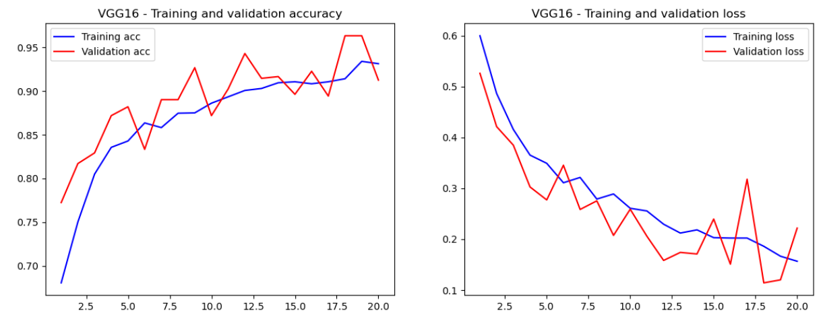
RESULTS
Accuracy and loss function of Training and Validation of VGG16

Slide 16
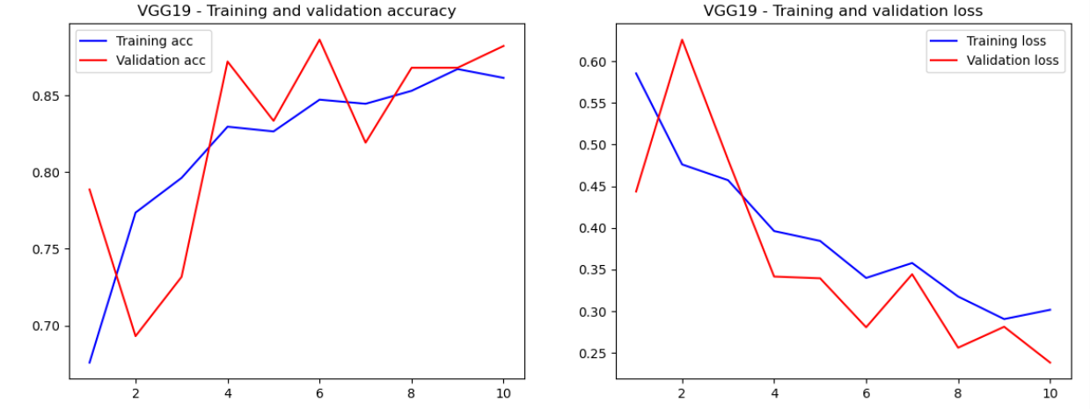
Accuracy and loss function of Training and Validation of VGG19

Slide 17
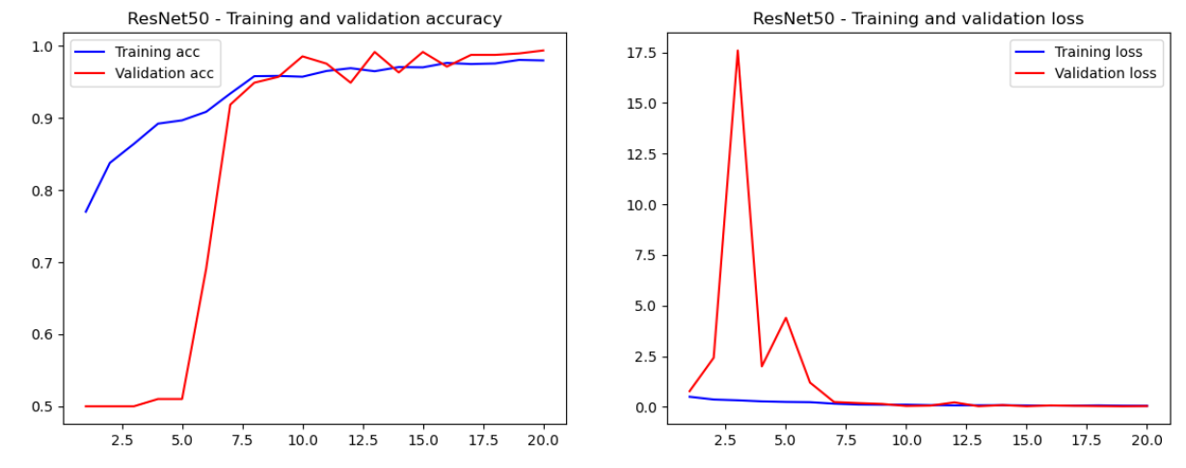
Accuracy and loss function of Training and Validation of RESNET-50

Slide 18
EXPERIMENTAL RESULTS
 | Precision | Recall | F1-Score | Support
Healthy | 0.96 | 0.98 | 0.97 | 81
Parkinson | 0.97 | 0.96 | 0.97 | 81
Accuracy |  |  | 0.97 | 162
Macro Avg | 0.97 | 0.97 | 0.97 | 162
Weighted Avg | 0.97 | 0.97 | 0.97 | 162
Classification report for VGG16
 | Precision | Recall | F1-Score | Support
Healthy | 0.75 | 0.96 | 0.84 | 81
Parkinson | 0.95 | 0.68 | 0.79 | 81
Accuracy |  |  | 0.82 | 162
Macro Avg | 0.85 | 0.82 | 0.82 | 162
Weighted Avg | 0.85 | 0.82 | 0.82 | 162
Classification report for ResNet50
 | Precision | Recall | F1-Score | Support
Healthy | 0.98 | 1.00 | 0.99 | 81
Parkinson | 1.00 | 0.98 | 0.99 | 81
Accuracy |  |  | 0.99 | 162
Macro Avg | 0.99 | 0.99 | 0.99 | 162
Weighted Avg | 0.99 | 0.99 | 0.99 | 162
Classification report for VGG19

Slide 19
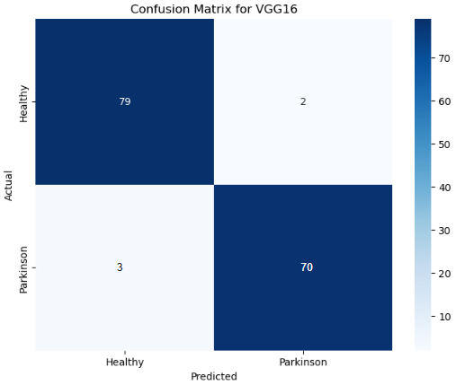
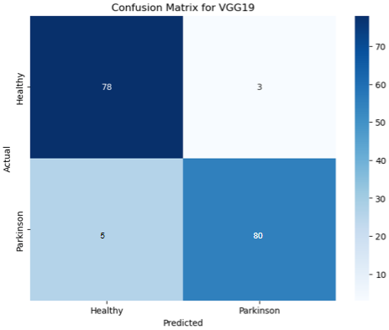

Slide 20
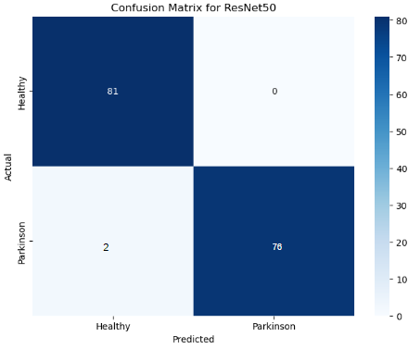

Slide 21
CONCLUSION
In this project, we successfully implemented and evaluated VGG16, VGG19, and ResNet50 convolutional neural network architectures for the classification of Parkinson's disease images. By employing extensive data augmentation techniques and leveraging pre-trained models, we enhanced the robustness and accuracy of our models. Each model demonstrated strong performance, with ResNet50 achieving the highest accuracy due to its deeper architecture and residual connections. The evaluation metrics, including accuracy, precision, recall, and confusion matrices, confirmed the models' effectiveness in distinguishing between the classes. This study highlights the potential of deep learning in medical image classification and sets the stage for future enhancements through hyperparameter tuning, ensemble methods, and the incorporation of larger datasets.

Slide 22


